Slide 1
Introduction to RStudio

Slide 2
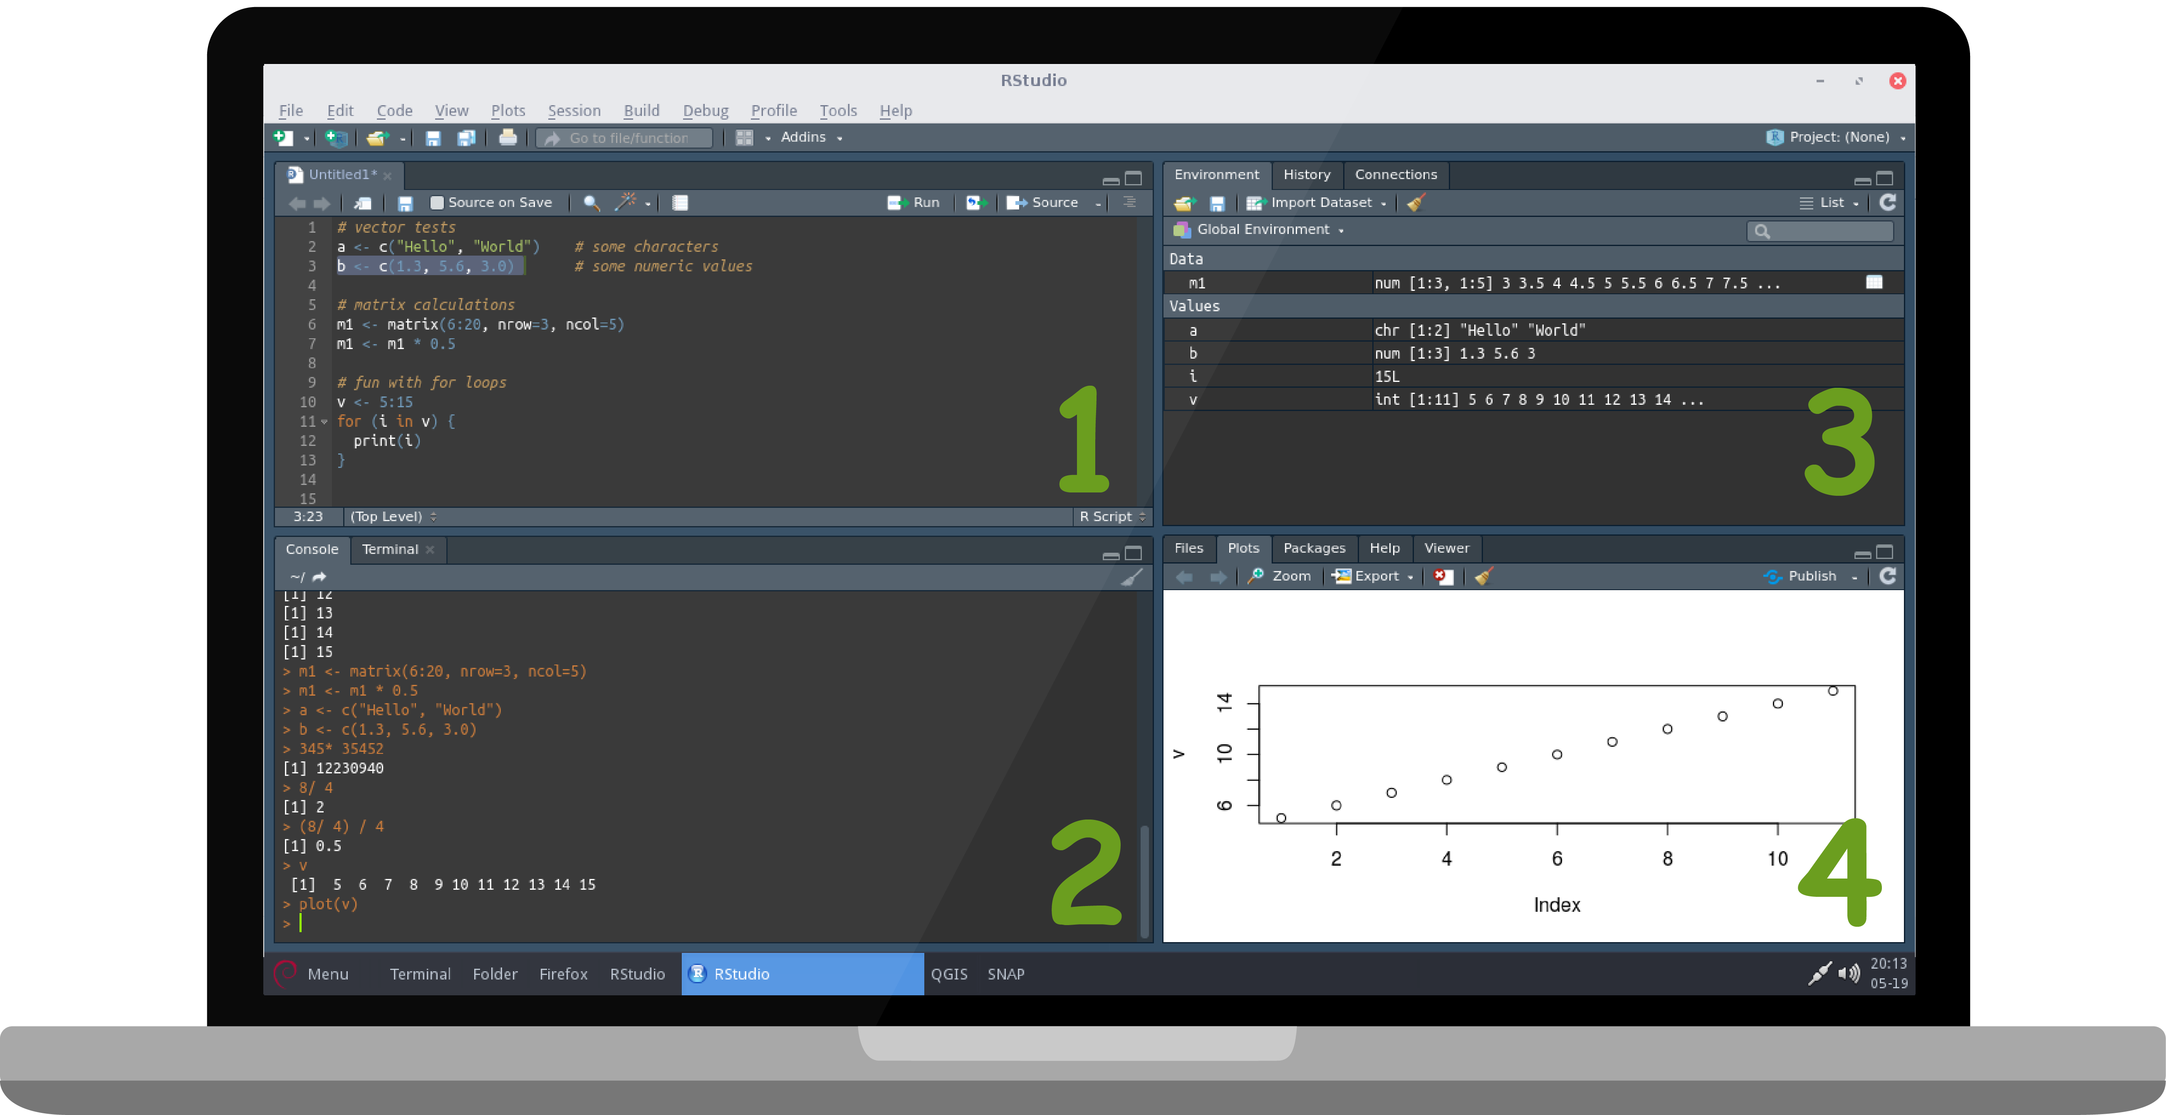
RStudio is an integrated development environment (IDE) specifically designed for R programming. It provides a user-friendly interface that makes writing, debugging, and managing R code easier.

Slide 3
Main Components of RStudio
Source Editor
-Used for writing and editing scripts.
2. Console
-Executes R commands interactively.
3. Environment/History Pane
-Displays variables, datasets, and command history.
4. Files/Plots/Packages/Help Pane
-Manage files, view plots, install packages, and access documentation.

Slide 4
Features of RStudio
Syntax highlighting and code completion
Integrated debugging tools
Project management support
Package installation and management
Visualization tools

Slide 5
Relationship Between R and RStudio
R is the programming language and computation engine.
RStudio is the environment used to write and run R code efficiently.
R can run without RStudio, but RStudio requires R to be installed.

